Slide 1
Analysis of Sender based and Reciever based flooding in MANETS
Chaitanya Sai Kumar Talluru
Venkata Bharath Malapati
Computer Science

Slide 2
Outline – Sender Based Flooding
Flooding
Broadcast storm
Minimum Forwarding Set Problem
Partition Based Algorithm
Fast geometric disk covering in a quadrant
Exact combinatorial disk covering in a quadrant

Slide 3
Flooding
Transmits the flooding message to its neighbors when it is the first time to receive it.
Flooding Enables the message transfer even without prior knowledge of topology.

Slide 4
Broadcast Strom
Redundant Rebroadcasts: IF the node decides to broadcast a message which is already broadcasted earlier to its neighbors will create redundancy.
Contention: This arries due to retransmission between close proximity nodes.
Collisions: Timing of retransmissions is closely correlated and can result in collisions.
When the message is first
transmitted, there is no is
no redundancy.
= These nodes receive redundant
messages sent at nearly the same
time which may cause collision
= The close proximity of these
nodes may cause contention for
space in the wireless channel

Slide 5
Minimum Forwarding Set Problem
The process of finding the minimum set of forwarding nodes i.e. from a set of one hop neighbors such that all the two hop neighbors are covered.

Slide 6
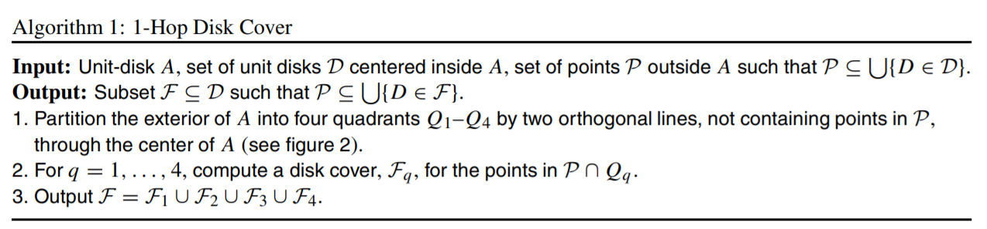
Algorithm 1 -- Partition Based Algorithm

Slide 7
Algorithm 1 -- Partition Based Algorithm
Partition in 4 quadrants by two orthogonal lines
Q₁
Q₂
Q₄
Q₃

Slide 8
Algorithm 1 (cont.)
2(c) remove fully covered disks
Q₁
R₄
Q₁
R₃
l₁
R₃
l₁
l₂
l₂
D2
R₂
l₃
D2
D3
R₂
l₃
D1
D3
l₄
D1
D4
R₁
Q₂
R₁
Q₄
Q₂
Q₄
Q₃
Q₃
Fq : D1 D2 D3 D4
Fq : D1 D2 D3
D4 is fully covered by D3, so remove it

Slide 9
Algorithm 1
2(d) Remove covered by two neighbors
Q₁
R₃
l₁
Q₁
R₃
l₁
l₃
D1
D3
l₂
R₁
D1
D2
D3
R₂
D3
Q₂
Q₄
l₃
R₁
D2
D2
D3
Q₂
Q₄
D1
D1
D1
D1
D2 is covered by D1 and D3 , so remove it
Q₃
Fq
Q₃
Output Fq : D1, D3

Slide 10
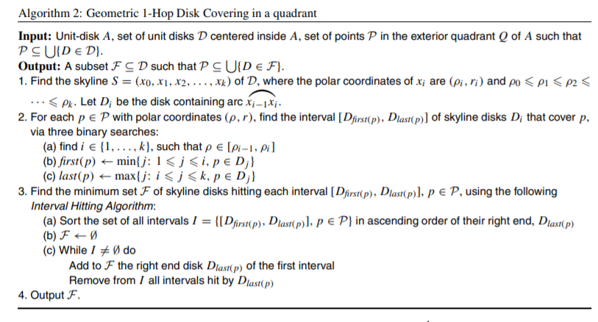
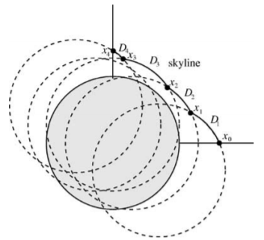
Fast geometric disk covering in a quadrant

Slide 11
Q₁
R₃
l₁
l₂
D1
D2
D3
R₂
l₃
R₁
Q₂
Q₄
Q₃

Slide 12
Runtime Analysis
Step 1 of the algorithm can be implemented in O(n log n) time using, e.g., an adaptation of the divide-and-conquer algorithm
The binary searches in step 2 also take O(n log n) time
Finally, the Interval Hitting Algorithm can be implemented in O(n log n).
Indeed, an interval is hit by the disk Dlast(p) if its left covering disk is before Dlast(p) in the skyline S.
Therefore, by traversing all intervals sorted in ascending order of their left ends Dfirst(p), we can delete each hit interval in constant time per interval.

Slide 13
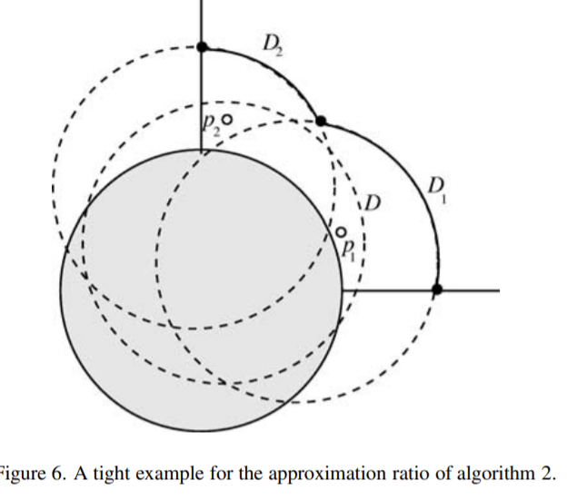
Remarks of Algorithm 2
Figure gives an instance when the optimum disk cover consisting of skyline disks has size 2, while there is a single (nonskyline) disk covering the two points of P.

Slide 14
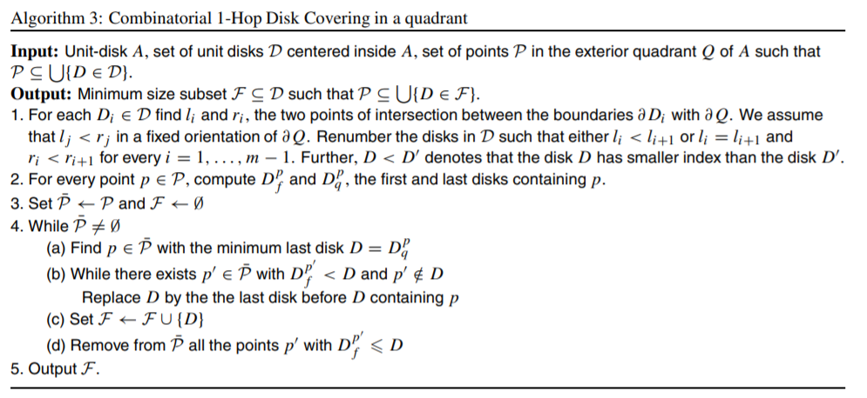
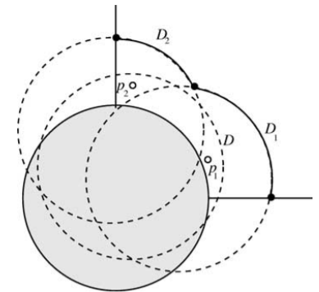
Exact combinatorial disk covering in a quadrant

Slide 15
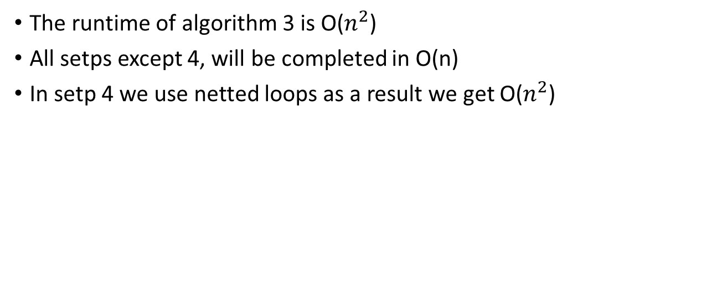
The runtime of algorithm 3 is O($n^{2}$)
All setps except 4, will be completed in O(n)
In setp 4 we use netted loops as a result we get O($n^{2}$)

Slide 16
Outline – Reciever Based Flooding
Literature Review of RBF in MANET’s
RBF algorithm work flow
coverage condition of RBF
RBF Algorithm 1
RBF-E1 algorithm
RBF-E2 algorithm
Simulations and Results
Conclusions

Slide 17
SBF Vs RBF
A sender-based flooding algorithm selects a subset of neighbors for a forwarding node to be the next hop forwarding nodes.
When a node decides to forward the flooding message, it attaches the list of its forwarding neighbors to the flooding message. i.e. along with message F – set information is forwarded to nodes.
A receiver-based flooding algorithm does not need to attach additional information to the flooding message.
Using a receiver-based algorithm, a node makes its forwarding decision when it receives the message.

Slide 18
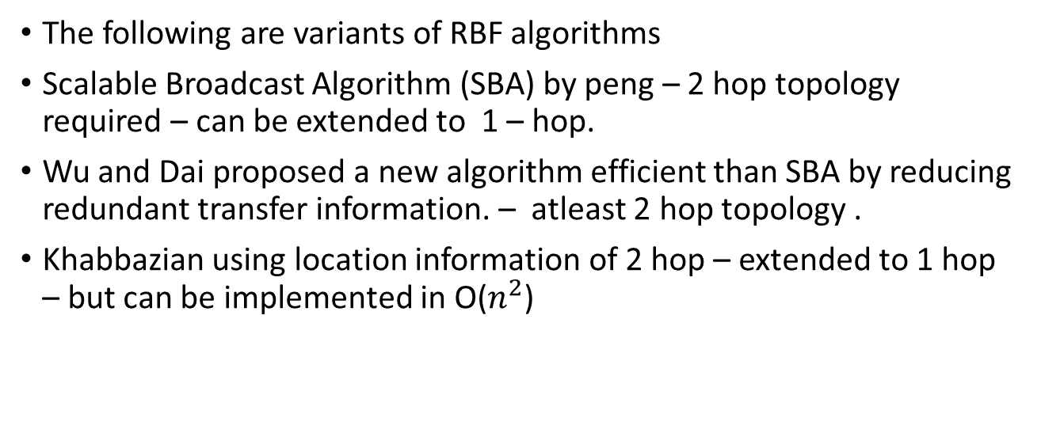
Literature Review of RBF in MANET’s
The following are variants of RBF algorithms
Scalable Broadcast Algorithm (SBA) by peng – 2 hop topology required – can be extended to 1 – hop.
Wu and Dai proposed a new algorithm efficient than SBA by reducing redundant transfer information. – atleast 2 hop topology .
Khabbazian using location information of 2 hop – extended to 1 hop – but can be implemented in O($n^{2}$)

Slide 19
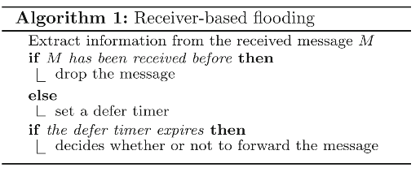
RBF algorithm work flow
when a node has a message to transmit, it initiates a defer timer by a random number and starts listening to the channel.
The node continues to listen until the channel is idle, then it starts decreasing the defer timer at the end of each time unit.
The message is broadcasted when the defer timer expires.

Slide 20
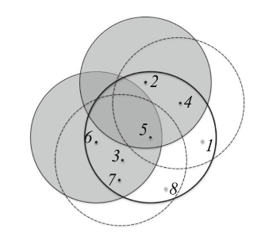
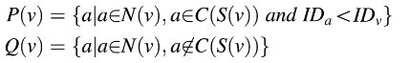
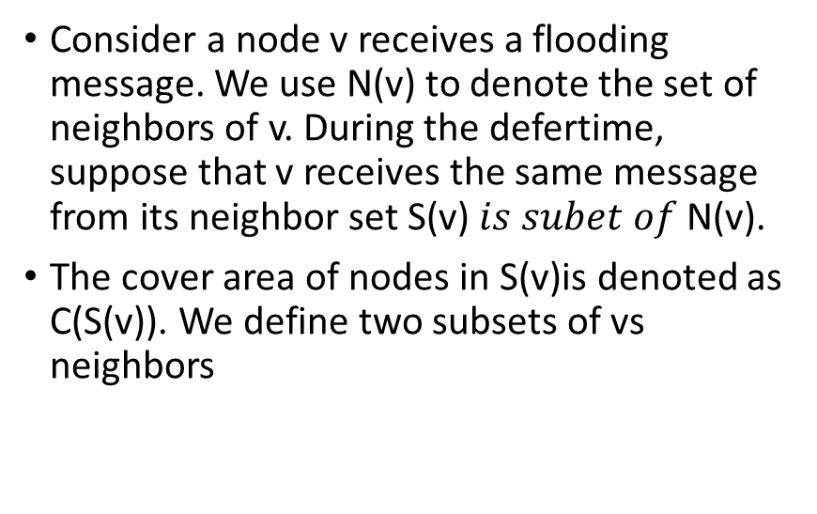
coverage condition of RBF
Consider a node v receives a flooding message. We use N(v) to denote the set of neighbors of v. During the defertime, suppose that v receives the same message from its neighbor set S(v)$is subet of$N(v).
The cover area of nodes in S(v)is denoted as C(S(v)). We define two subsets of vs neighbors

Slide 21
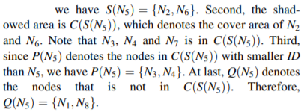
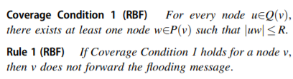
coverage condition of RBF

Slide 22
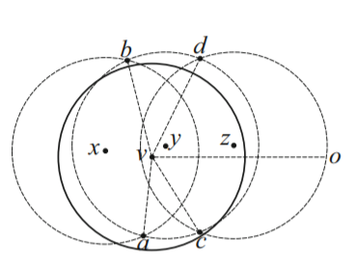
RBF Algorithm 1 – Stage 1
In the first half of Algorithm we first identify S(v), N(V).
Then Compute C(S(V)) -- coverage
compute P(v) and Q(v) using

Slide 23
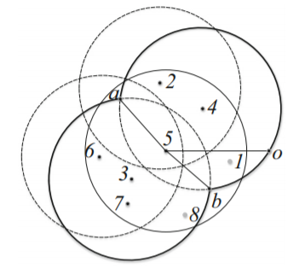
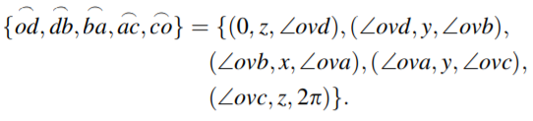
RBF Algorithm 1 – Stage 2
In the Second half of Algorithm we check that whether every node in Q(v) is covered by C(P(v)).

Slide 24
Analysis of Algorithm
Stage 1
N(v) is sorted with respect to angles which is done using quick sort as a result it take time O(nlogn).
Calculating P(v) and Q(v) can be done in O(n), where n – neighbors of node v.
Stage 2
Q(v) is sorted with respect to angles in ascending order.
So, Q(v) take O(mlog m), m – no of elements of Q(v)
Computing C(P(v)) takes klog k , k –no of elements of P(V)
Finally, since k<= n and m<= n as a result overall time
Complexity will be O(nlog n)

Slide 25
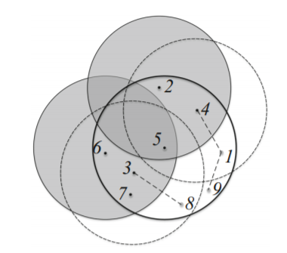
RBF-E1 algorithm
The coverage condition of RBF can be further improved, where nodes in Q(v) only need to be path-covered by nodes in P(v).
The coverage condition of RBF-E1:
The main idea of RBF-E1 is that a node in Q(v) is only required to be connected to a node in P(v) by a path, instead of directly covered by a node in P(v).
The intermediate nodes along the path must have smaller IDs than v.

Slide 26
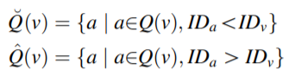
RBF-E1 algorithm
A maximal independent set of a graph is an independent set that is not a subset of any other independent set.
In the implementation of RBF-E1, the neighbor sets of v are used as follows:

Slide 27
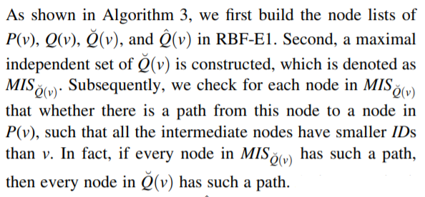
RBF-E1 algorithm

Slide 28
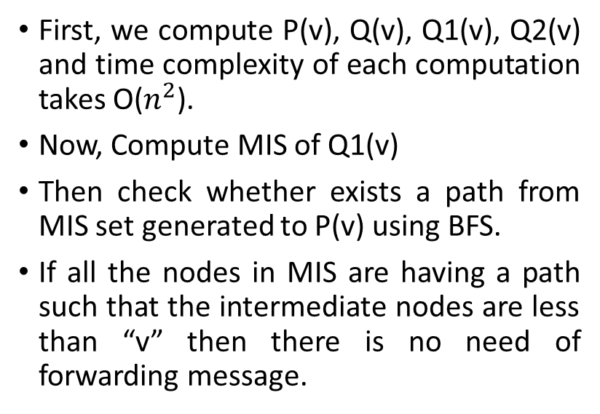
RBF-E1 algorithm
First, we compute P(v), Q(v), Q1(v), Q2(v) and time complexity of each computation takes O($n^{2}$).
Now, Compute MIS of Q1(v)
Then check whether exists a path from MIS set generated to P(v) using BFS.
If all the nodes in MIS are having a path such that the intermediate nodes are less than “v” then there is no need of forwarding message.

Slide 29
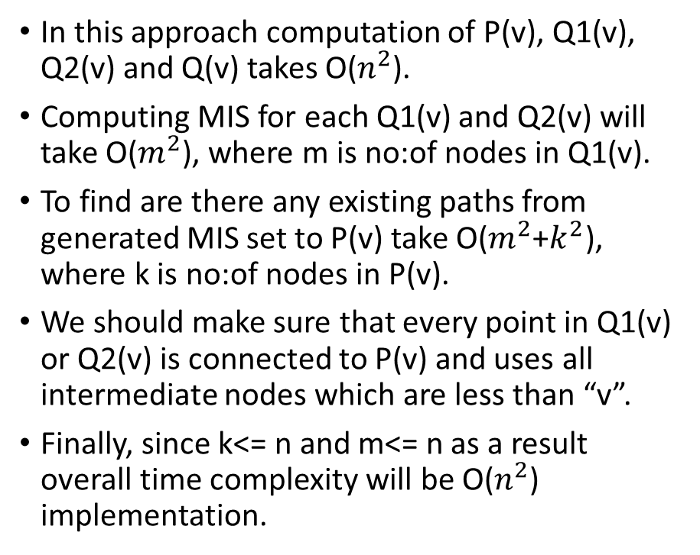
RBF-E1 algorithm – Time Complexity
In this approach computation of P(v), Q1(v), Q2(v) and Q(v) takes O($n^{2}$).
Computing MIS for each Q1(v) and Q2(v) will take O($m^{2}$), where m is no:of nodes in Q1(v).
To find are there any existing paths from generated MIS set to P(v) take O($m^{2}$+$k^{2}$), where k is no:of nodes in P(v).
We should make sure that every point in Q1(v) or Q2(v) is connected to P(v) and uses all intermediate nodes which are less than “v”.
Finally, since k<= n and m<= n as a result overall time complexity will be O($n^{2}$) implementation.

Slide 30
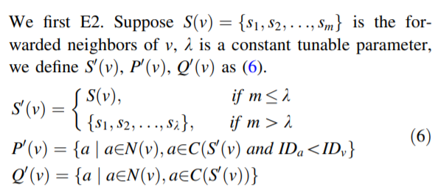
RBF-E2 algorithm
The main idea of RBF-E2 is to reduce the coverage condition of RBF from ‘‘the coverage of nodes’’ to ‘‘the coverage of nodes’ projections’’.

Slide 31
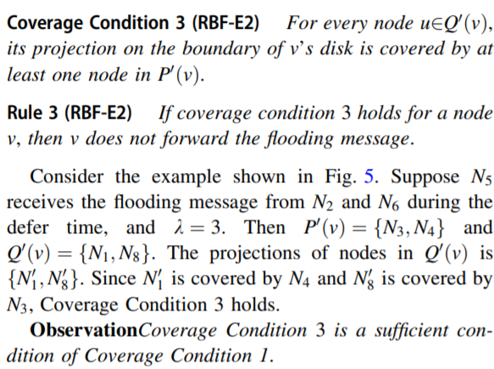
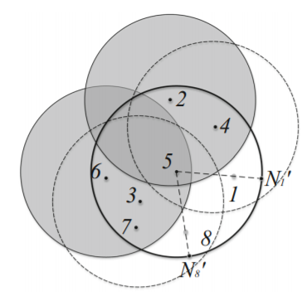
RBF-E2 algorithm

Slide 32
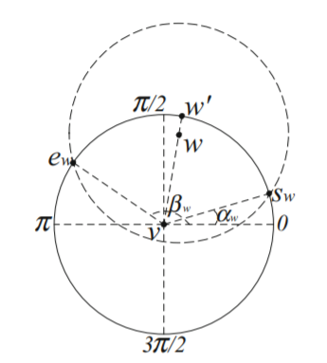
RBF-E2 algorithm Stage 1
The basic idea is to iteratively erase the covered points from the point set, and it can be proved that the iteration ends in constant rounds.
We First 1, compute the p(v), q(v) and arc of P(v) i.e. C(P(v)) and angles of Q(v)(start and end angles that intersecting with circle centered at “V”)

Slide 33
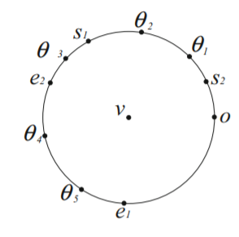
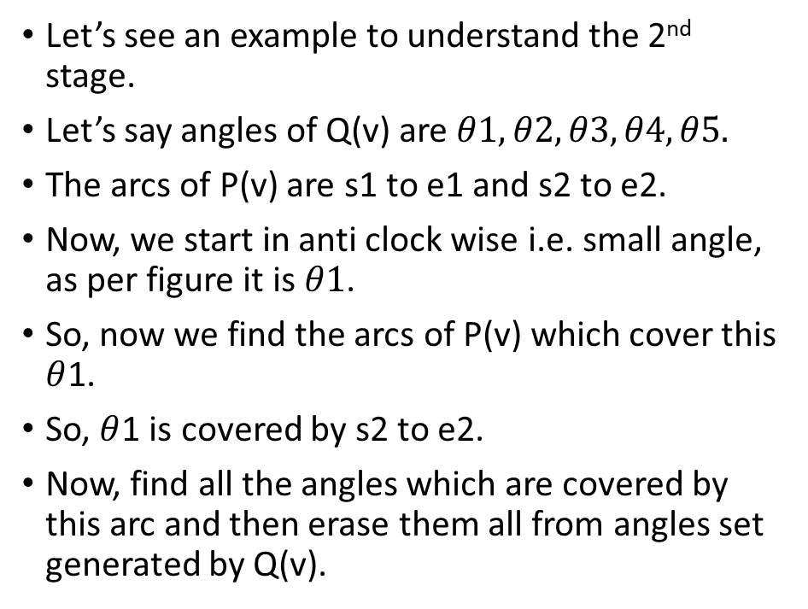
RBF-E2 algorithm Stage 2
Let’s see an example to understand the 2nd stage.
Let’s say angles of Q(v) are $θ1,θ2,θ3,θ4,θ5.$
The arcs of P(v) are s1 to e1 and s2 to e2.
Now, we start in anti clock wise i.e. small angle, as per figure it is $θ1$.
So, now we find the arcs of P(v) which cover this $θ$1.
So, $θ$1 is covered by s2 to e2.
Now, find all the angles which are covered by this arc and then erase them all from angles set generated by Q(v).

Slide 34
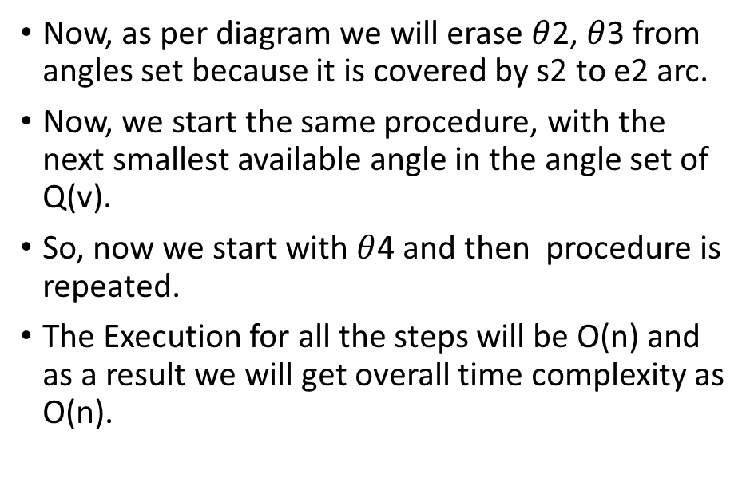
RBF-E2 algorithm Stage 2
Now, as per diagram we will erase $θ$2, $θ$3 from angles set because it is covered by s2 to e2 arc.
Now, we start the same procedure, with the next smallest available angle in the angle set of Q(v).
So, now we start with $θ$4 and then procedure is repeated.
The Execution for all the steps will be O(n) and as a result we will get overall time complexity as O(n).

Slide 35
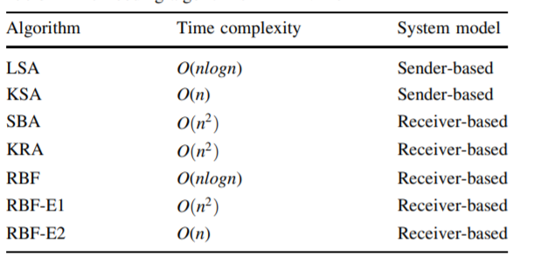
Final Comparisons between Algorithms

Slide 36
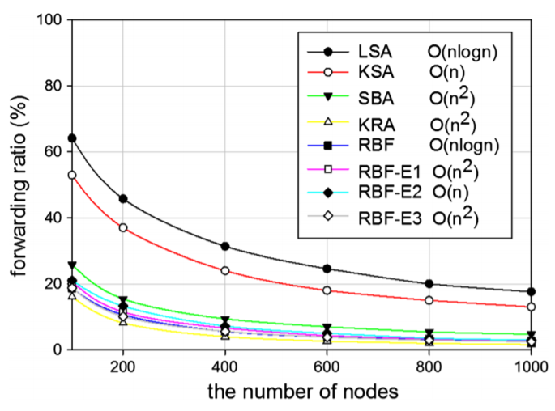
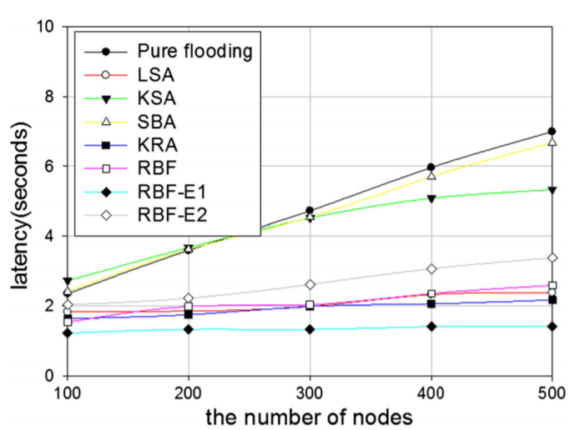
Results

Slide 37
References
Calinescu, G., Mandoiu, I. I., Wan, P. J., & Zelikovsky, A. Z. (2004). Selecting forwarding neighbors in wireless ad hoc networks. Mobile Networks and Applications, 9(2), 101–111.
Bai, X., Wei, X. & Bai, S. Efficient receiver-based flooding in mobile ad hoc networks. Wireless Netw 26, 17–31 (2020). https://doi.org/10.1007/s11276-018-1779-z

Slide 38
Thank you!

